Slide 1
The 9th Unmanned Aerial Vehicle
Conference
A great platform to exchange ideas, share experiences and foster collaborations
Welcome!
徐一宁
236109

Slide 2
Keynote 1
Task Offloading for Post-Disaster Rescue in Unmanned Aerial Vehicles Networks
谢伊凡236108
Notes:
Hello everyone it is my great honor to stand before you today as we gather for this important international conference.
I am truly excited to have the opportunity to share with you some thoughts and insights on Task Offloading for Post-Disaster Rescue in Unmanned Aerial Vehicles Networks

Slide 3
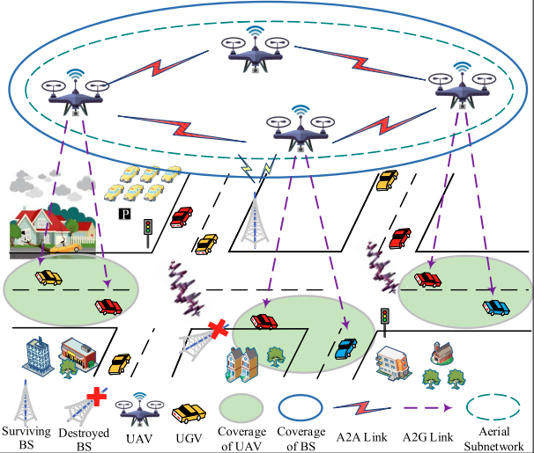
Introduction
Natural disasters
The frequency of recorded natural disasters has surged almost five-fold globally.
Advantages of drones
Due to their low cost, high mobility and deployment flexibility, UAVs can easily enter the affected areas that are otherwise difficult to reach . As such, utilizing the onboard sensors and wireless communications of UAVs, the digital map of the post-disaster area can be drawn.
谢伊凡236108
Notes:
NATURAL disasters, such as earthquakes, mudslides and wildfires, could cause loss to thousands of lives and properties, while also incurring economic damage to the affected areas.
The emerging UAVs combined with artificial intelligence (AI) technology have revolutionized the methodology of natural disaster rescue. Due to their low cost, high mobility and deployment flexibility, UAVs can easily enter the affected areas that are otherwise difficult to reach [4]. So With its mobility, flexibility, and communication capability, the UAV will become increasingly promising to play a major role in the post-disaster rescue [6]–[8].

Slide 4
Contributions
Framework: We propose a tripartite dynamic cooperation framework among UAVs, UGVs and base stations during the post-disaster rescue.
Scheme: We devise a distributed stable matching algorithm that makes full use of the dynamic characteristics of UAVs and UGVs.
Validation:The feasibility and effectiveness of the proposed scheme are evaluated by extensive simulations. Numerical results demonstrate that the proposed scheme can not only maximize the utility of UAVs, but also reduce the average delay, compared with conventional schemes.
谢伊凡236108
Notes:
Based on the above circumstances, we have indeed made some progress.
First of all
Additionally
And the last

Slide 5
Thanks!
谢伊凡236108

Slide 6
Keynote 2
Wireless Communications with Unmanned Aerial Vehicles: Opportunities and Challenges

Slide 7
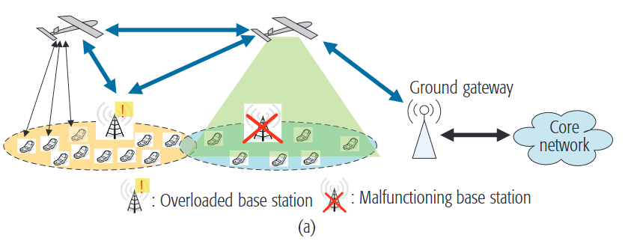
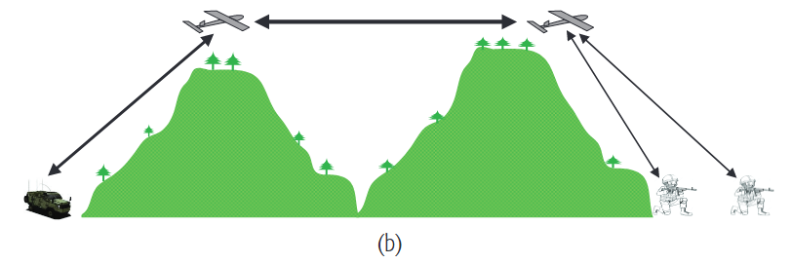
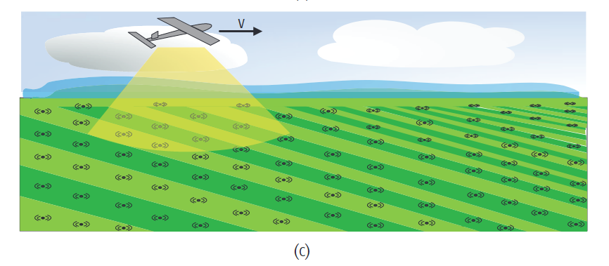
Abstract
UAV-aided ubiquitous coverage
UAV-aided relaying
UAV-aided information dissemination and data collection
Notes:
本篇论文在此研究方向主要做出了三种贡献
1.构建了关于无人机，无人车以及基站的动态合作框架，以便于三者更好地配合工作
2. 设计了一种新颖的分布式稳定匹配方法，以便充分利用无人机和无人车的动态特性。
3. 在上述两种设计的基础上进行大量仿真实验，充分证明了他们的方案让无人机能够更高效的工作，还能有效降低通信传输时延。

Slide 8
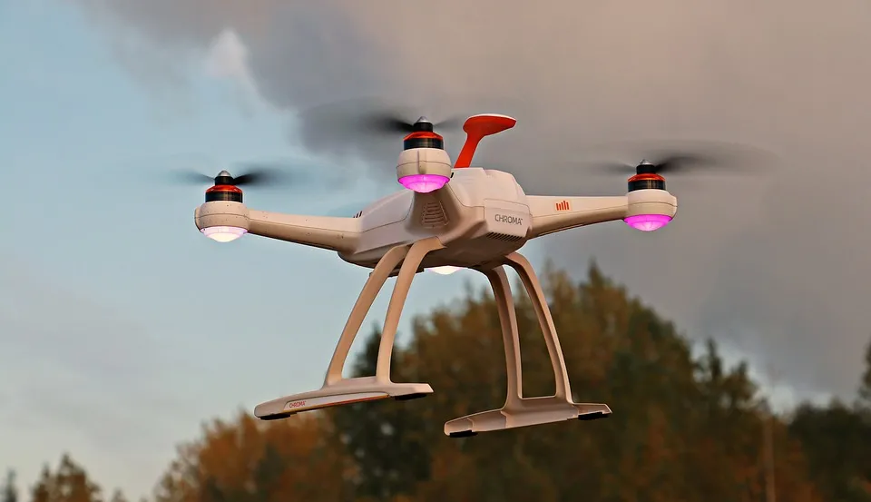
Conclusion
1. Overview of UAV-aided wireless communications
2. Key design considerations for UAV communications
3. Key performance enhancing techniques utilizing UAV controlled mobility
Notes:
本篇论文在此研究方向主要做出了三种贡献
1.构建了关于无人机，无人车以及基站的动态合作框架，以便于三者更好地配合工作
2. 设计了一种新颖的分布式稳定匹配方法，以便充分利用无人机和无人车的动态特性。
3. 在上述两种设计的基础上进行大量仿真实验，充分证明了他们的方案让无人机能够更高效的工作，还能有效降低通信传输时延。

Slide 9
Q&A

Slide 10


Q&A for keynote 1
Question
Answer
How is the stable network between unmanned aerial vehicles (UAVs) and unmanned ground vehicles (UGVs) ensured in the VFC system to avoid transmission contention?
The VFC system employs an iterative algorithm that considers both network stability and communication efficiency. By evaluating the actual impact of task offloading in each iteration, the system adjusts task assignments to avoid contention, ensuring a stable communication environment.
Notes:
本篇论文在此研究方向主要做出了三种贡献
1.构建了关于无人机，无人车以及基站的动态合作框架，以便于三者更好地配合工作
2. 设计了一种新颖的分布式稳定匹配方法，以便充分利用无人机和无人车的动态特性。
3. 在上述两种设计的基础上进行大量仿真实验，充分证明了他们的方案让无人机能够更高效的工作，还能有效降低通信传输时延。

Slide 11
Q&A for keynote 2
Question
Answer
In practical terms, what real-world applications can benefit the most from the proposed UAV-assisted communication system?
The proposed system holds promise for applications such as disaster response, surveillance, and remote sensing, where UAVs can provide flexible and rapidly deployable communication links in challenging and dynamic environments.
Notes:
本篇论文在此研究方向主要做出了三种贡献
1.构建了关于无人机，无人车以及基站的动态合作框架，以便于三者更好地配合工作
2. 设计了一种新颖的分布式稳定匹配方法，以便充分利用无人机和无人车的动态特性。
3. 在上述两种设计的基础上进行大量仿真实验，充分证明了他们的方案让无人机能够更高效的工作，还能有效降低通信传输时延。

Slide 12
The 9th Unmanned Aerial Vehicle Conference
Closing Speech
Thank you all for being a part of this journey
王一帆
236094

